Slide 1
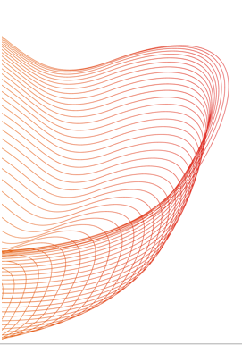
Leveraging Deep Learning and Large Language Models to Identify Clinical Exposure Changes Due to Extrinsic and Intrinsic Factors
Launch and Learn webinar
Subtitle: A Comparative Study
Hamed Meshkin
January 17, 2025
Notes:
Thank you all for taking the time to join this presentation titled, "Leveraging Deep Learning and Large Language Models to Identify Clinical Exposure Changes Due to Extrinsic and Intrinsic Factors.
This presentation aims to explore how large language models can enhance regulatory processes by leveraging advanced Natural Language Processing techniques.
So, our study highlights how these models can be effectively implemented in secure local environments for critical tasks for example from FDA drug labels to identify pharmacokinetic drug-drug interactions.

Slide 2
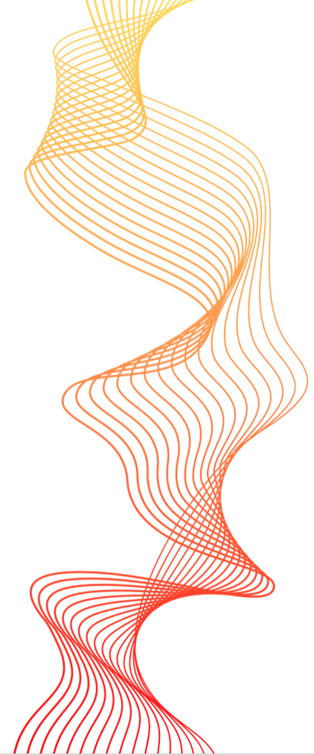
Outline
Prior Study (Fine-tuning LLM to extract clin pharm information with custom training dataset)
Objective
Background and Motivation (Extracting drug-drug Interaction + object and precipitant drug)
BioBert Directional DDI model
Result and Performance
Second Study (Directly Using LLM to extract clin pharm information with Few/zero training)
Objective
Background (Extracting drug-drug Interaction + patients' intrinsic factors)
LLM In-context learning (Few and Zero-shot learning)
Model Evaluation
Summary
Notes:
I’ll start with our Prior Study, which focused on fine-tuning large language models to extract clinical pharmacology information using a custom training dataset. In this section, we’ll discuss:
The objective of the study—what we aimed to achieve and why it’s important.
The background and motivation, particularly the need for extracting drug-drug interactions along with the roles of the object and precipitant drugs.
The development of the BioBERT Directional DDI model and how it was fine-tuned specifically for this task.
Lastly, we’ll review the results and performance of this model.
Next, we’ll move on to the Second Study, which takes a different approach by directly using LLMs to extract clinical pharmacology information with minimal training, specifically leveraging few-shot and zero-shot learning.
In this section, we’ll:
Define the objective of this study.
the background on challenges related to this task.
Explain the concept of Large language model in-context learning,
Conclude this section with the model evaluation,
Finally, I’ll wrap up the presentation with a summary

Slide 3
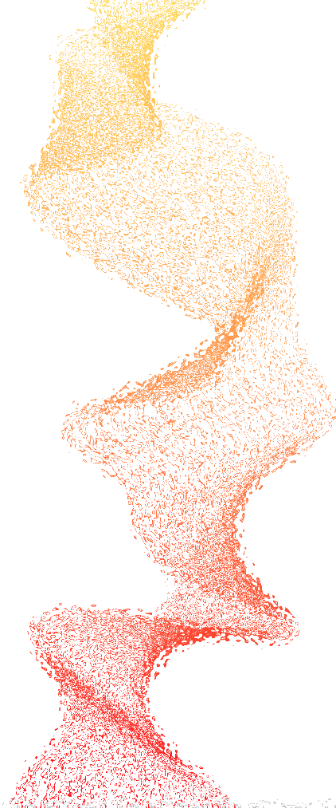
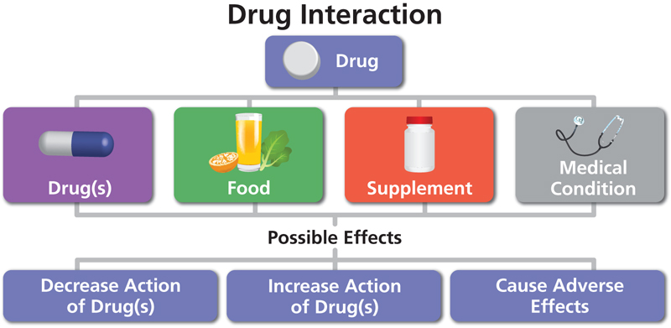
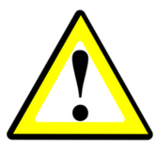
1. Goal (prior): Fine-tuning LLM to extract clin pharm information using custom dataset
Extract critical biomedical data, including pharmacokinetic drug-drug interactions, object and precipitant drugs, from literature.
Automatically Extract directional drug–drug interaction (DDI) from the natural text to identify the change in one drug’s clinical exposure due to the pharmacokinetic DDI of other drugs
Task 1
Task 2
“Because substances in grapefruit juice may inhibit the metabolism of Pimozide by CYP3A4, patients should be advised to avoid grapefruit juice.” [1]
Object?
Grapefruit juice is precipitant and Pimozide is the object drug
“Verapamil therapy may increase serum levels of cyclosporine.” [1]
Verapamil is precipitant and Cyclosporine is the object drug
Precipitant?
[1] https://dailymed.nlm.nih.gov/dailymed/fda
Notes:
For our first study. The primary goal was to fine-tuned a large language model that can extract clinical pharmacology information from biomedical text. This includes extracting critical biomedical data from sources such as drug labels or biomedical literature. In a broader aspect, we focused on pharmacokinetic drug-drug interactions, which are important in understanding how one drug affects another’s drug’s clinical exposure [].
Imagine a patient taking two drugs, where one drug unexpectedly reduces the efficacy of the other one. [] Therefor, there is a directional relationship between these two drugs and it’s important because it can have life-threatening consequences. []
So, there are two primary tasks expected from our model. First, it identifies sentences containing DDIs. Second task, it distinguishes the roles of the drugs involved: the 'object drug,' whose exposure is altered, and the 'precipitant drug,' which causes the change.
We have two examples from dailymed, we know that both relates to pk DDI ( Read the example)
in the first sentence, grapefruit juice inhibits Pimozide metabolism, making it the precipitant and Pimozide the object drug.
In the second sentence, Verapamil increases Cyclosporine levels, identifying Verapamil as the precipitant and Cyclosporine as the object drug.
Extracting and classifying such information is invaluable for guiding therapeutic decisions, detecting adverse interactions, and simplifying drug development processes.

Slide 4
1. Introduction (prior): Two-Step NLP Pipeline for Pharmacokinetic DDIs
Natural language processing (NLP) methods to automatically extract and process information from biomedical literature
Relationship Extract (RE)
NLP Model to identify PK DDI sentences
Pharmacokinetic drug-drug interaction sentences (PK-DDI)
Biomedical literature corpus
`
Non-PK DDI
PK DDI
No Pharmacokinetic drug-drug interaction sentences (Non PK-DDI)
Notes:
The primary goal of our first task is [] to identify whether a sentence describes a pharmacokinetic drug-drug interaction as PK-DDI or a non-PK DDI interaction
this process called Relationship Extraction (RE). First, we need to train our NLP model using Biomedical literature corpus to automatically classify each sentence as PK DDI or non-pk-DDI. []

Slide 5
1. Introduction (prior): Two-Step NLP Pipeline for Pharmacokinetic DDIs
Natural language processing (NLP) methods to automatically extract and process information from biomedical literature
Relationship Extract (RE)
NLP Model to identify PK DDI sentences
NLP Model to identify Precipitant and object drugs
Pharmacokinetic drug-drug interaction sentences (PK-DDI)
Biomedical literature corpus
Pharmacokinetic drug-drug interaction sentences (PK-DDI)
PK DDI
No Pharmacokinetic drug-drug interaction sentences (Non PK-DDI)
Notes:
[] Our second task is Named Entity Recognition (NER). Once we know a sentence describes a PK DDI, we further identify which drug acts as the ‘object’ (the one affected) and which acts as the ‘precipitant’ (the one causing the effect). This slide shows a schematic of how both tasks fit together. First, the RE model classifies them into PK vs. non-PK DDI. Then, the NER model pinpoints the relevant drugs in PK sentences and labels them accordingly.

Slide 6
1. Introduction (prior): Two-Step NLP Pipeline for Pharmacokinetic DDIs
Natural language processing (NLP) methods to automatically extract and process information from biomedical literature
Relationship Extract (RE)
NLP Model to identify PK DDI sentences
Pharmacokinetic drug-drug interaction sentences (PK-DDI)
Biomedical literature corpus
PK DDI
No Pharmacokinetic drug-drug interaction sentences (Non PK-DDI)
Name Entry Recognition (NER)
NLP Model to identify Precipitant and object drugs
Pharmacokinetic drug-drug interaction sentences (PK-DDI)
Precipitant drug
Object drug
1) Traditional Machine Learning
2) Pre-trained large Language models
Notes:
[] Our second task is Named Entity Recognition (NER). Once we know a sentence describes a PK DDI, we further identify which drug acts as the ‘object’ (the one affected) and which acts as the ‘precipitant’ (the one causing the effect). This slide shows a schematic of how both tasks fit together. First, the RE model classifies them into PK vs. non-PK DDI. Then, the NER model pinpoints the relevant drugs in PK sentences and labels them accordingly.
To build these models, we have two options:[]
1 traditional machine learning methods ,
2. and more advanced, pre-trained large language models

Slide 7
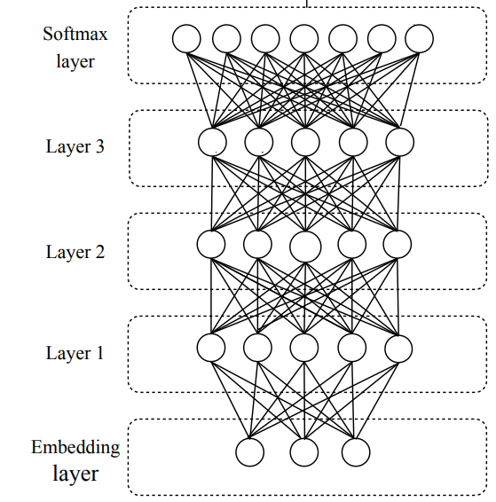
1. Background: traditional NLP vs Pre-trained Language Models
1) Traditional Neural Network
Disadvantages
Training is slow and computationally expensive.
Long sequences cause vanishing gradients, leading to loss of word relationships
Advantages
Fine-tune a Language model
2) Pre-trained large language model
Pre-trained models drastically reduce training time.
Notes:
Traditional Machine Learning: In this approach, we train the model using labeled data, where model learns the relationship between different words.
But the problem is Slow Training issue: Training these models requires large datasets and extensive computational resources, which making all process slow and inefficient.
And second issue is the Vanishing Gradient Problem: When dealing with long sequences, traditional neural networks often lose the relationship between distant words. For example, in a long sentence, the connection between the first and last word may be lost, making it difficult for the model to capture context accurately.[]
The second approach is Pre-trained Transformer-Based LLMs: Alternatively, we can leverage pre-trained transformer models, which already understand complex language patterns. [] These models only require fine-tuning on specific biomedical tasks, making them faster and more efficient to implement. So, Even though the model is pre-trained, we can fine-tuned them for a specific task of our interest by adjusting the models' parameters. This is similar to additional training but requires fewer resources.
Overall , transformer-based Large Language Models offer significant advantages over traditional neural networks by enabling faster training, and using less rescores.

Slide 8
1. Methodology (Prior): BioBert Fine-tuning
BioBERT = Pre-trained BERT + Additional pre-training on biomedical data
BioBert model pre-trained with PubMed
Bert
325 structured product tables
(Pre-specified by TAC2019)
PubMed abstracts
PMC full-text articles
21593 annotated sentences
Fine-Tuning
Model Training
13B words
BioBert Directional DDI model¹
BioBert 340M parameters
81 structured Product labels
(Pre-specified by TAC2019)
10592 unannotated sentences
Predict precipitant and object drugs in pharmacokinetic DDIs
Model Validation
Relationship Extract (RE)
Named Entry Recognition (NER)
QA
Evaluate Performance
Zirkle, Joel, et al. "Deep learning-enabled natural language processing to identify directional pharmacokinetic drug–drug interactions." BMC bioinformatics 24.1 (2023): 413.
Notes:
This slide highlights the work done in our previous project, which focused on fine-tuning a pre-trained BioBERT model for pharmacokinetic drug-drug interaction as (PK-DDI) extraction.
BioBERT, a language model trained on 13 billion words from PubMed abstracts and PMC full-text articles, has 340 million parameters, making it highly suitable for tasks such as relationship extraction, named entity recognition (NER), and question answering. In this project, we fine-tuned BioBERT specifically for identifying PK-DDI sentences and distinguishing between object drugs and precipitant drugs. []
Here, the diagram illustrates the complete process:
First is Fine-Tuning: We fine-tuned the pre-trained BioBERT model using 325 structured product tables provided by the FDA (TAC2019), resulting in a custom model known as the BioBERT Directional DDI model.
The second process Model Validation: So, the fine-tuned model was then tested and validated using 81 structured product labels again from TAC2019, ensuring robust performance across a variety of scenarios.

Slide 9
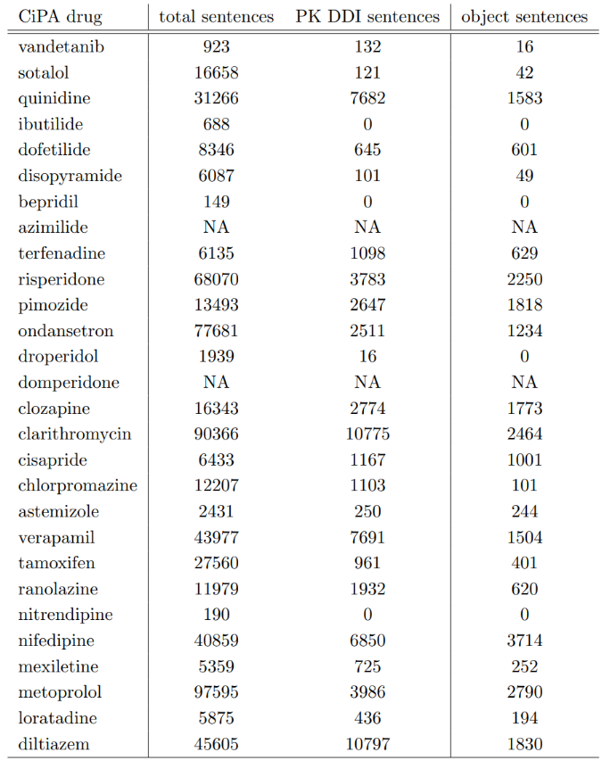
1. Result (Prior): BioBert Directional DDI Model (fine-tuned BioBERT)
1st task: PK-DDI Identification Task
Real world problem
From a list of 28 drugs from the Comprehensive in vitro Proarrhythmia Assay (CiPA) Initiative.
Recall | 80.6 %
Precision | 82.7%
F-score | 81.6%
Performance of the sentence classification step.
2nd task: Identifying Object and Precipitant drugs in PK DDI sentences
 | Object | Precipitant
Recall | 93.7% | 94.6%
Precision | 100% | 100%
F-score | 96.8% | 97.2%
Performance of the named entity recognition step
Zirkle, Joel, et al. "Deep learning-enabled natural language processing to identify directional pharmacokinetic drug–drug interactions." BMC bioinformatics 24.1 (2023): 413.
Notes:
To obtain the model’s performance, we use key validation metrics: recall, precision, and F-score. When these metrics altogether achieve high values—close to 100%—it indicates the model's robustness and ability to make accurate predictions.
For the first task, which involves PK-DDI sentence identification I mean RE task, the model achieved a precision recall and F-score bigger higher 80 percent . []
For the second task—identifying object and precipitant drugs in PK-DDI sentences, NER task:
The model achieved 100% precision for both object and precipitant drugs, indicating no false positives.
The F-scores were also exceptionally high, with 96.8% for object drugs and 97.2% for precipitant drugs, reflecting both high recall and precision. []
[] In a later phase, we applied the Bio-BERT Directional DDI model to analyze sentences from FDA labels as part of the Comprehensive in vitro Proarrhythmia Assay (CiPA) initiative, as a real-world problem to identifying PK-DDI relationships . First column we have drug’s name. second column we have total sentences per each drug which overall there are 46 thousand sentences extracted from FDA labels. The third column shows the PK-DDI sentences that appeared for each drug. And finally, the last column that demonstrate the number of time a drug targeted as object drug,
for example for verapamil we have 15 hundred times it shows the PK of this drug have changed due to a presence of another drug.
Altogether, these metrics demonstrate the high reliability of the fine-tuned BioBERT model for automatically extracting directional pharmacokinetic drug-drug interaction information from biomedical text.

Slide 10
2. Second study: Using LLM to extract clin pharm information with few/zero training
Objective: Fine-tuning a pre-trained model for a new task is impossible unless we acquire an annotated dataset containing positive and negative examples related to the specific task.
Notes:
For the second study, we focuses on the extraction of clinical pharmacology information using more advanced transformable-based large language models with minimal or few training.
The main objective here is to address a key challenge that when using models like BioBERT, fine-tuning is required , is essential, for every new task. Which means that Training or Fine-tuning, demands a large annotated dataset, which can be difficult and time-consuming to obtain, specifically for highly specialized tasks like extracting pharmacokinetic drug-drug interactions.
So, with the limitations of fine-tuning, our goal in this study is to “implementing open-source LLMs through a secure local network and using these models to perform various natural language processing tasks even when large numbers of training examples are unavailable.[]

Slide 11
2. Second study: Using LLM to extract clin pharm information with few/zero training
Objective: Fine-tuning a pre-trained model for a new task is impossible unless we acquire an annotated dataset containing positive and negative examples related to the specific task.
Goal:
Extract critical biomedical data, such as pharmacokinetic drug-drug interactions, precipitant -object drug, and intrinsic factors and so on, from literature using locally hosted Large Language Models (LLMs).
Ensure data privacy to Implement secure locally hosted Large Language Models.
Notes:
There are two benefits using these models actually enable us to:
Extract critical biomedical data—such as pharmacokinetic interactions, object precipitant drugs or patients’ intrinsic factors from unstructured biomedical literature using in-context learning without requiring labeled training data. It can be quickly adapted to cover other tasks without large quantities of task-specific training data.
And second benefit is Ensure data privacy and regulatory compliance, which I’ll explain it in next slide.

Slide 12


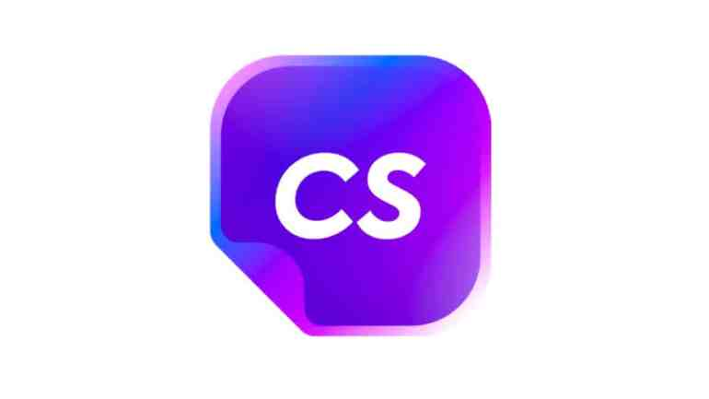




2. Pre-trained Transformer-based Large Language Model
ChatGPT
Google Gemini
Chat Sonic
Perplexity AI
Jasper AI
Claude
Objectives
One can use our previous technique, HOWEVER, for any task we need to prepare sufficiently large training/validation dataset and consequently fine-tun the model
One can use one of these online sources, HOWEVER, there is a risk of data leakage associated with the utilization of online platforms
Implement secure, locally hosted Large Language Models to automate extraction and classification of interaction data while ensuring data privacy
Notes:
Currently, several prominent companies and research groups are actively developing advanced large language models capable of performing advanced NLP tasks without the need for fine-tuning. []
No exaggerating, but Every day, numerous platforms and tools are launched, offering a wide range of AI-driven solutions.
Here, we highlight some of the most widely known models, such as ChatGPT, Google Bard, and Claude. []
While these models provide impressive capabilities, using external online sources poses significant risks, particularly regarding data privacy and leakage—a critical concern in regulatory and clinical settings. []
[] Also, while our previous BioBERT-based model remains useful, it requires fine-tuning for every new task. []
These factors collectively motivated us to deploy a large language model (ChatGPT-like) model through our local network, ensuring both data security and flexibility for various extraction of clin pharm information .

Slide 13
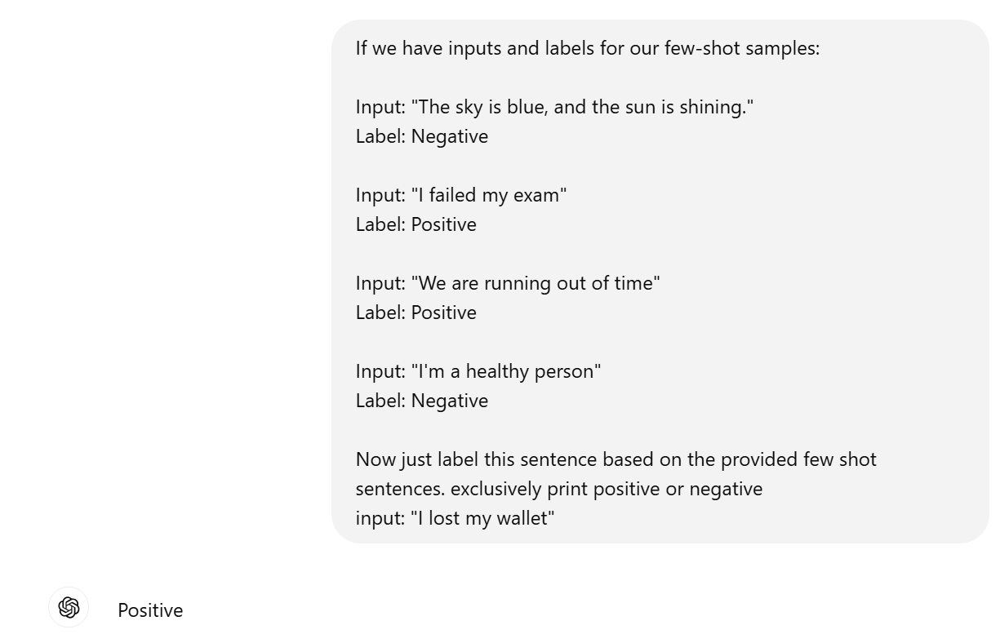


2.In-context learning: Few/Zero shot training
Using Few-Shot learning to train ChatGBT
FSL
Large data collection
Example 1: PK DDI sentence Example 2: PK DDI sentence
Example 3: Non-PK DDI sentence Example 4: Non-PK DDI sentence
+
Prompt + (sentences set)
FSL input
Query set Prediction
Pre-processing
Model Inference
Tokenization
Post-Processing
Few-shot learning (FSL) practice of feeding a machine learning model with a very small amount of training data to guide its predictions
Notes:
This slide illustrates the workflow of a transformer-based large language model in the concept of in-context learning. While these models are typically pre-trained, additional learning can happen through approaches like few-shot or zero-shot learning.
For Few-shot learning we introduce a small amount of labeled training data to guide the model's predictions. [] For example, in this case, I used zero-shot learning with ChatGPT by presenting four sentences labeled in a way that contrasts with their actual meaning.[] using few-shot learning to train the model.
For our case, we fed our LLM with 4 labeled sentences: two describing pharmacokinetic drug-drug interactions as pk-DDI and two describing non-PK DDI sentences. These examples, along with validation sentences, are provided in the form of a prompt question to the model.
Before the model can make predictions, the input data undergoes several key preprocessing steps:
Pre-processing and tokenization: The input sentences and the prompt are tokenized and encoded, converting them into a numerical format suitable for the model.
Model Inference: The encoded input is processed by the LLM to generate predictions.
Post-processing: The output is decoded to determine whether the provided sentence describes a PK-DDI or a non-PK DDI interaction.

Slide 14
2.In-context learning: Few/Zero shot training
FSL
Large data collection
Example 1: PK DDI sentence Example 2: PK DDI sentence
Example 3: Non-PK DDI sentence Example 4: Non-PK DDI sentence
+
Prompt + (sentences set)
FSL input
Query set Prediction
Pre-processing
Model Inference
Tokenization
Post-Processing
Few-shot learning (FSL) practice of feeding a machine learning model with a very small amount of training data to guide its predictions

Slide 15
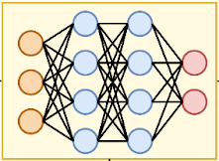

2.In-context learning: Few/Zero shot training
Transformer Model
Flan-T5-XXL
Tk-instruct
T0PP
Vicuna
BioBert
Large Labeled Dataset
Large language transformer Models
Zero-shot learning
Query set Prediction
Prompt Query + (sentences set)
Pre-processing
Hugging Face
Model Inference
Tokenization
Post-Processing
Zero-shot learning (ZSL) is a Machine Learning paradigm that introduces the idea of Query samples with class labels that were never observed during the initial training phase
11
Notes:
In zero-shot learning, unlike few-shot learning, the model makes predictions without any labeled examples for the specific task. Instead, it relies entirely on its pre-trained knowledge and the provided prompt query.
However, the model processing is the same as Zero-shot learning contain pre-processing, tokenization and post-processing.
These capability as Few shot or zero shot learning allows the model to generalize to new tasks without requiring additional fine-tuning or labeled data.[]
For our purpose we employed pre-trained transformer models that we used during our validation process FLAN-T5-XXL
Tk-Instruct
T0pp
Vicuna
BioBERT
to benchmark which models are suitable for extracting clin pharm information
These models are all accessible through the Hugging Face platform, which provides a centralized repository for a wide variety of pre-trained models

Slide 16
2. Pre-trained Large Language Transformer Models
Model | Parameter size | Trained source | Strengths | Weaknesses
Deep-Seek | 32B | Distilled from DeepSeek-R1, trained on diverse text/code corpus with reinforcement learning | Strong reasoning ability, efficient compared to larger models | May underperform in open-ended generation compared to ChatGPT-4
Tk-Instruct | 11B | Dataset of text and code from a variety of sources, including books, articles, code repositories, and conversations. | Following instructions, completing requests thoughtfully | Can be slow and computationally expensive
Flan-T5-XXL | 11B | Massive dataset of text and code, including books, articles, code repositories, and conversations. | General-purpose LLT, good at tasks that require general knowledge | Can be slow and computationally expensive
T0pp | 11B | Dataset of text and code from a variety of sources, including books, articles, code repositories, and social media. | Text classification, sentiment analysis, question answering | Not as good at tasks that require following instructions as Tk-Instruct
Vicuna | 13.7B | Dataset of code from GitHub | Code generation, understanding and translating code | Not as good at general-purpose NLP tasks as Flan-T5-XXL
ChatGPT3 | 175B | Dataset of text and code from a variety of sources, including books, articles, code repositories, and conversations. | Conversational AI, chatbots | Can be less informative than other LLT models
BioBERT | 0.34B | Dataset of biomedical text, including clinical notes, research papers, and drug labels. | Biomedical NLP tasks such as clinical text processing and drug discovery | Not as good at general-purpose NLP tasks as other LLT models
Notes:
Now let’s compare these model together, This table presents a comparison of Large Language Models that we evaluated for this study based on their parameter size, training data sources, strengths, and weaknesses.
Sorry for the wordy table to save time let’s focusing on the blue section for parameter size. As you can see, there’s a significant variation in the models’ sizes and capabilities. The differences in parameter size are primarily influenced by the amount and type of data used for training, as well as the specific architecture of the models.
For example:
BioBERT, which has 340 million parameters, is the smallest model listed here. Since it was pre-trained specifically on biomedical text, it performs well in domain-specific tasks like biomedical NLP but often requires fine-tuning to improve its performance further on specialized tasks.
On the other hand, we have Vicuna, the largest model on this list, with 1.37 trillion parameters. Its large size and extensive training data make it highly capable in tasks requiring code understanding, translation, and general-purpose NLP tasks.

Slide 17
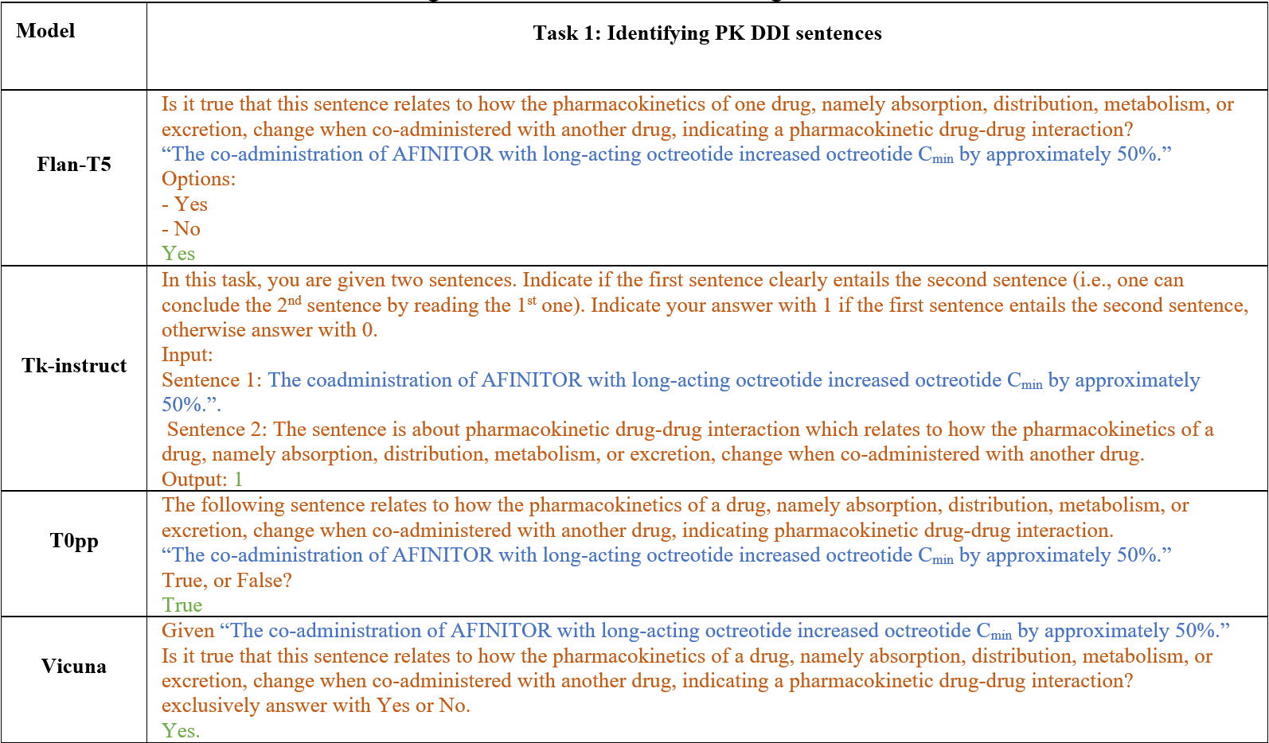
2. Prompt Question: PK-DDI
Notes:
This slide presents the prompts we used for evaluating each large language
What you see here are the prompts fed into different models. Based on the model developers’ recommendations, we tested a unique prompt format for each model to achieve the best performance.
Blue text are the sentences extracted directly from FDA drug labels, which describe a potential PK-DDI.
Red text represents the prompt question given to the model, instructing it to identify whether the sentence describes a pharmacokinetic drug-drug interaction.
Green text is the model’s output or the classified label, indicating whether the sentence is a PK-DDI or not.
Let’s take the first example with Flan-T5:
The sentence extracted from the drug label is: “The co-administration of AFINITOR with long-acting octreotide increased octreotide Cmin by approximately 50%.”
The prompt asks the model: “Is it true that this sentence relates to how the pharmacokinetics of one drug, namely absorption, distribution, metabolism, or excretion, change when co-administered with another drug?”
The model outputs ‘Yes’, correctly identifying that this sentence describes a PK-DDI.
During our performance evaluation, we noticed that using prompts with detailed explanations of what constitutes a PK-DDI led to better results. Therefore, we decided to include a short description in each prompt to guide the model more effectively. This adjustment helped improve the model’s ability to classify PK-DDI sentences accurately.
Overall, this approach illustrates the importance of prompt engineering in zero-shot and few-shot learning scenarios, as the format and content of the prompt can significantly influence model performance.

Slide 18
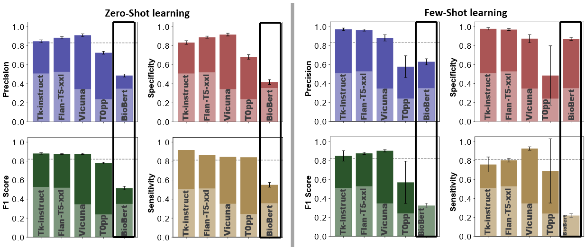
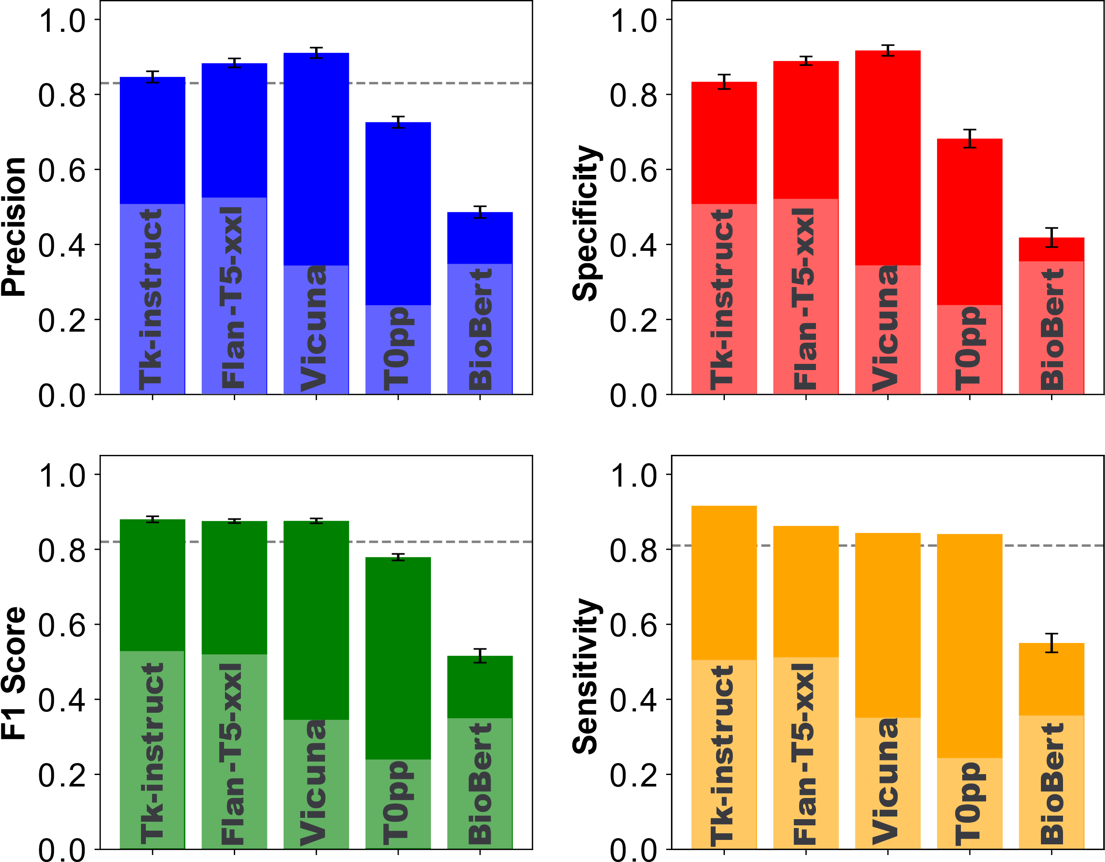
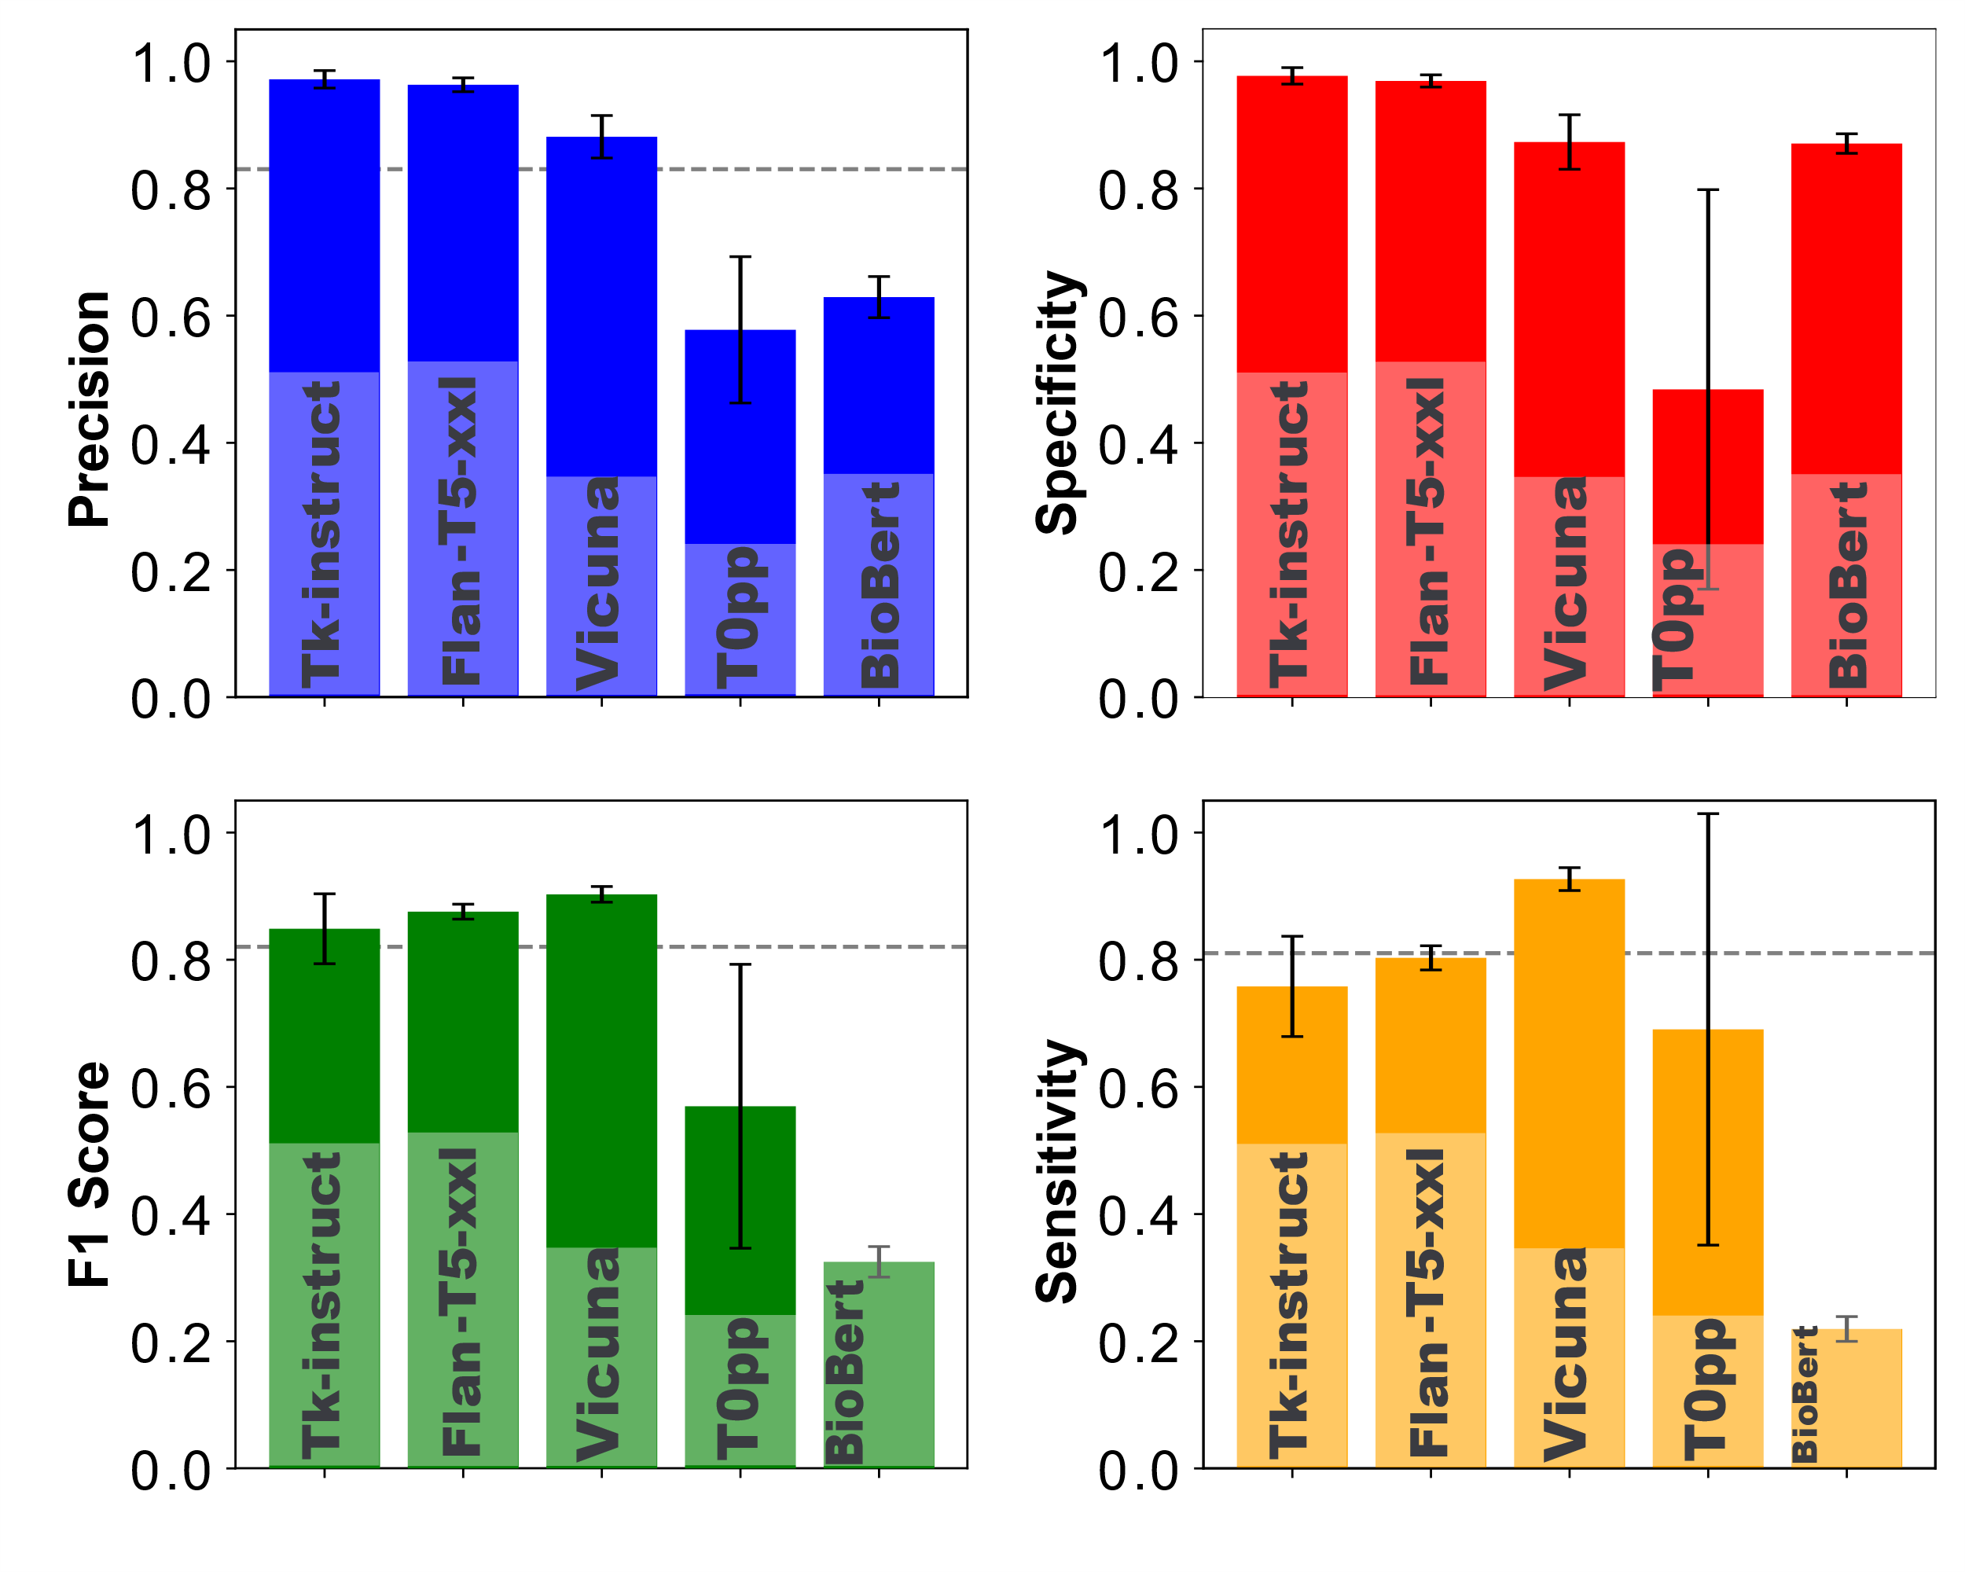
2. Model Evaluation: Validate LLMs performance by identifying PK-DDI sentences to compare it with the prior project
Prior study
second study
Fine-tuned BioBert evaluated through 10592 sentences
Zero / Few-shot learning evaluated by 10242 (PK and Non-Pk DDI) sentences
Fine-tuned BioBert model
Zero-Shot learning
Few-Shot learning
Notes:
Here we, summarizes the PK-DDI evaluation results by comparing the performance of different models, including our fine-tuned BioBERT model from the prior research
As we discussed before, The fine-tuned BioBERT model was evaluated on 10,592 sentences, achieving over 80% precision, recall, and F-score across all metrics. []
Here we have the evaluation result For our selected large language model, each bar represents a different model, and each color corresponds to the specified evaluation metrics for zero-shot and few-shot learning. The dashed-line is the result from fine-tuned BioBert model, we can compare them directly.
For both zero-shot and few-shot learning, models like Tk-Instruct, Flan-T5-XXL, and Vicuna consistently delivered high performance, achieving more than 90% precision and specificity.
T0pp performed well in zero-shot learning, with metrics between 80% and 90%, but its performance in few-shot learning, particularly for specificity and F-score, was below optimal.
And ss expected, the non-fine-tuned BioBERT model performed poorly, emphesizing the need for task-specific fine-tuning to achieve reliable results for this model.
In conclusion, these results demonstrate that transformer-based models like Tk-Instruct, Flan-T5-XXL, and Vicuna can achieve high accuracy in zero-shot and few-shot scenarios when appropriate prompts and examples are used. Also, fine-tuning models like BioBERT significantly enhances their ability to classify PK-DDI sentences.

Slide 19
2. Evaluate LLM performance on a new task
Prior study
“Because substances in grapefruit juice may inhibit the metabolism of Pimozide by CYP3A4, patients should be advised to avoid grapefruit juice.” [1]
Object?
Grapefruit juice is precipitant and Pimozide is the object drug
“Verapamil therapy may increase serum levels of cyclosporine.” [1]
Verapamil is precipitant and Cyclosporine is the object drug
Precipitant?
2nd Task: Identifying intrinsic factors, such as age, gender, genetics, additional disease and organ function, that may alter clinical exposure
“Following a single 20mg oral Zolpidem tartrate dose, mean Cmax and AUC were found to be two times and five times higher, respectively, in hepatically-compromised patients.” [1]
Zolpidem's clinical exposure have been impacted by Intrinsic factors of liver diseases.
Intrinsic factors?
[1] https://dailymed.nlm.nih.gov/dailymed/fda
Notes:
Now that the new approach, using large language model in-context learning rather than fine-tuning, outperforms in identifying PK-DDI sentences, we became interested in performing the task related to object and precipitant as we performed for fine-tuned BioBert model . however, we change it a little to define a new task to also test the flexibility of these models.
For the second task instead of identifying object and precipitant drugs in drug-drug interactions, we focus on identifying how patient’s intrinsic factors—such as age, race, weight, gender, genetics, and organ function—can affect the clinical exposure of a drug . In this context, the precipitant is not another drug or compound but rather intrinsic factors that can alter the drug's pharmacokinetics.
We have an example here:

Slide 20
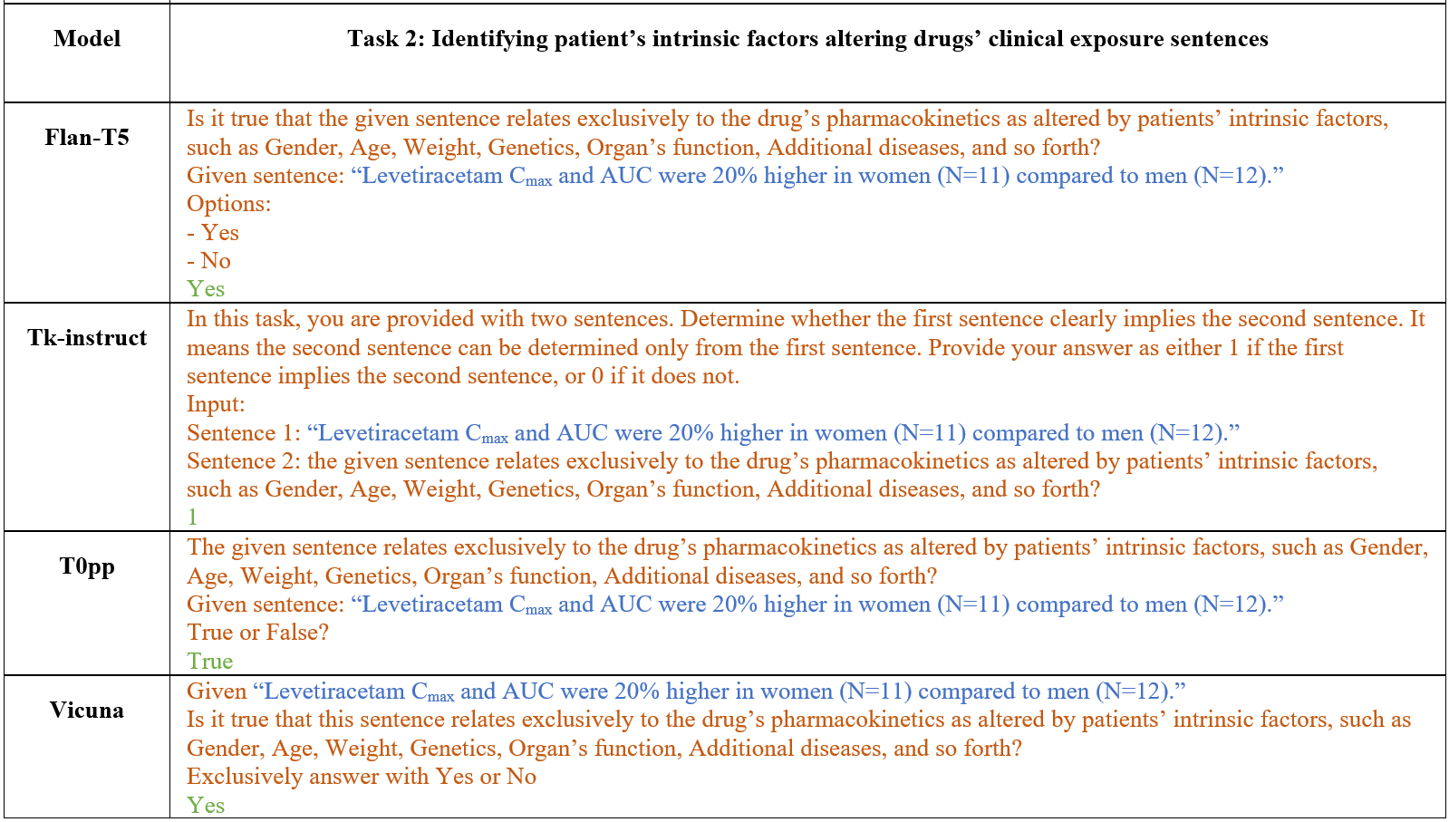
2. Prompt Questions: Intrinsic factors affecting drug clinical exposure
Notes:
These are the prompts we used for different models to classify sentences that describe patient’s intrinsic factors influencing drug exposure.
Similar to PK-DDI classification.
Blue text: These are sentences directly extracted from FDA drug labels,
Red text: This represents the prompt question,
Green text: This is the model’s output or the classified label,
for Flan-T5:
The extracted sentence is: ‘Levetiracetam Cmax and AUC were 20% higher in women (N=11) compared to men (N=12).’
The corresponding prompt asks: ‘Is it true that the given sentence relates exclusively to the drug’s pharmacokinetics as altered by patients’ intrinsic factors, such as gender, age, weight, genetics, organ function, additional diseases, and so forth?’
The model outputs ‘Yes’, indicating that the sentence indeed describes intrinsic factors influencing drug exposure.
Similar to the first task on PK-DDIs, we observed that including a short explanatory detail in the prompt—specifically mentioning the intrinsic factors—helped improve the model’s performance. This further illustrates the importance of carefully crafting prompts to guide models effectively in zero-shot and few-shot learning scenarios.

Slide 21
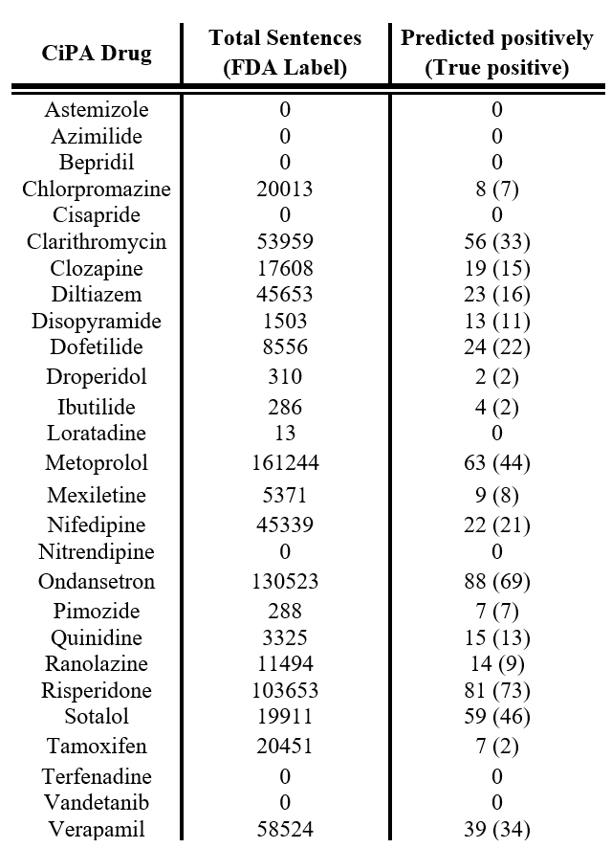
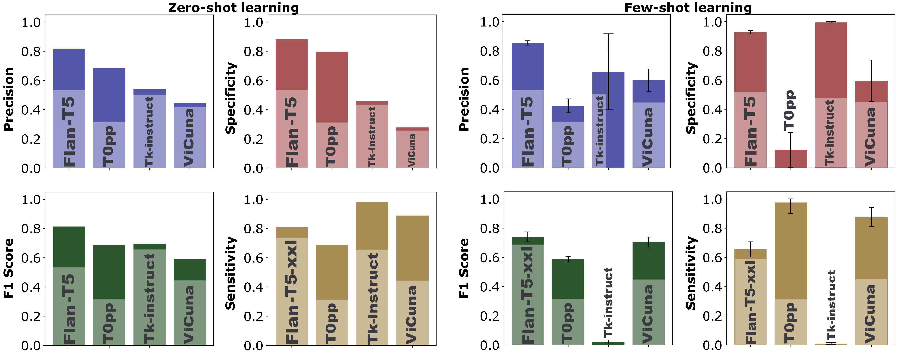
2. Model Evaluation: Intrinsic factors affecting drug clinical exposure
Real world problem
Zero and Few-shot learning evaluated by 500 sentences For sentence classification task focused on intrinsic factors that affect drug clinical exposure (198 positive and 302 negative sentences)
From a list of 28 drugs from the Comprehensive in vitro Proarrhythmia Assay (CiPA) Initiative. 708,024 sentences being extracted from the labels
precision rate 78.5%
Notes:
This slide shows the results of evaluating zero-shot and few-shot learning models on a sentence classification task focused on identifying intrinsic factors that alter drug clinical exposure. We annotated 500 sentences, consisting of 198 positive as patient’s intrinsic factor affect’s the cinical pharmacokinetiks and 302 negative sentences.
For Zero-Shot Learning:
For zero-shot learning, we evaluated models Flan-T5, T0pp, Tk-Instruct, and Vicuna.
As shown in the graphs, Flan-T5 demonstrated the highest performance in terms of precision, specificity, and F1 score, followed by T0pp.
In few-shot learning only Flan-T5 once again achieved the best performance, especially in terms of specificity and F1 score. []
To demonstrate the practical applicability of our approach, we applied it to 28 drugs from the Comprehensive in vitro Proarrhythmia Assay (CiPA) initiative, extracting 7 hundred thousand sentences from FDA labels.
The right-hand table shows the results, where:
Total sentences represent the number of extracted sentences for each drug.
Predicted positively indicates the number of sentences classified as describing intrinsic factors, with the true positives shown in parentheses.
Overall, our approach achieved a precision rate of 78.5%,
Unlike the fine-tuned BioBERT approach, which requires two steps—first, identifying PK-DDI sentences, and second, classifying the object and precipitant drug—these large language models require only one step, where running the model to identify the patient intrinsic factor is enough.
In conclusion, this evaluation highlights the potential of large language models to automate the extraction of intrinsic factors affecting drug exposure from large-scale biomedical text, supporting real-world regulatory applications.

Slide 22
Summary
Prior Study
For any task such as identify the clinical exposure, change due to PK DDI from a sentence there are naturally three steps:
Obtain annotated dataset to fine-tune the pre-trained language model.
Identify sentences that carry DDI information in the PK category.
Identify the precipitant and objects drugs in those sentences.
Second Study
Using large language model make it feasible to extract clinical pharmacology information.
We first test it by extracting PK-DDI sentences using four well known LLMs (Tk-Instruct, Vicuna, T0pp, and Flan-T5-XXL)
Apply a randomly new task (patients' intrinsic factors) without fine-tuning.
Both zero-shot and few-shot learning provided excellent performance.
These models stand out because they don’t require fine-tuning, making them easier to implement compared to the fine-tuned BioBERT model.
Our results demonstrate the feasibility of implementing a ChatGPT-like model within the FDA network with secure local deployment.
Future Work
LLM Image Processing Capabilities
User-Friendly Interfaces
Real-Time Adaptation
Notes:
In the first study, we aimed to identify clinical exposure changes due to pharmacokinetic drug-drug interactions (PK-DDIs). This process involved three key steps:
Obtain an annotated dataset to fine-tune a pre-trained language model.
Identify sentences containing Drug-drug Interaction information categorized as PK-DDI.
Extract precipitant and object drugs from those sentences identified as PK-DDI. []
Second Study
The second study demonstrated how large language models (LLMs) can make it feasible to extract clinical pharmacology information without requiring fine-tuning. We conducted this study as follows:
We first tested the models on PK-DDI sentence classification, using four well-known LLMs: Tk-Instruct, Vicuna, T0pp, and Flan-T5-XXL.
Next, we applied the models to a new task—identifying intrinsic factors affecting drug clinical exposure, such as age, weight, and genetics.
Both zero-shot and few-shot learning approaches provided excellent performance.
These models stood out because they didn’t require fine-tuning, making their implementation and usage much simpler compared to the fine-tuned BioBERT model.
Ultimately, our results demonstrate the feasibility of deploying a ChatGPT-like model within our network, ensuring secure local environment and efficient extraction of regulatory data. []
For future work LLM Image Processing Capabilities: similar to what we did on text extraction, we can use large language models (LLMs) with the capability to accept and process images. This would enable automated extraction of relevant information from drug labels, clinical charts, and medical images Develop user-friendly interfaces to facilitate the adoption of these models by non-technical users, enabling broader application within the FDA network.
Real-Time Adaptation: where models can update or refine their knowledge dynamically based on new data without requiring retraining from scratch.

Slide 23
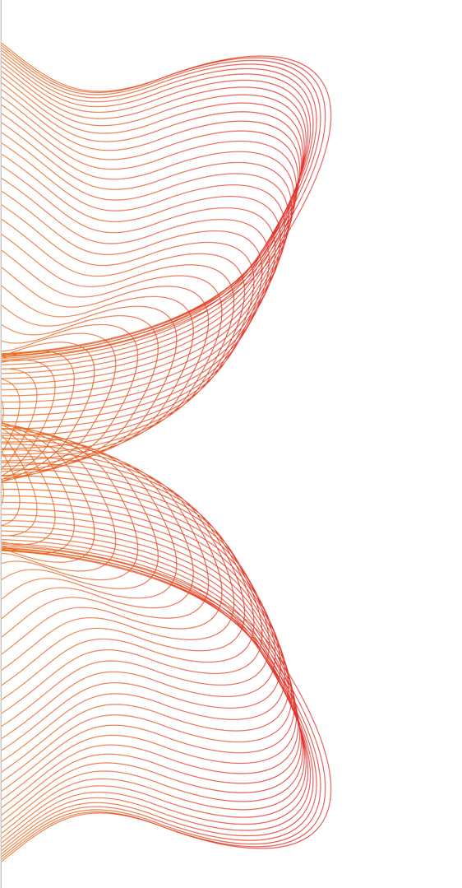
Acknowledgment
DARS Mechanistic Modeling Team
Zhihua Li
John Mann
Joel Zirkle
Shilpa Chakravartula
Anik Chaturbedi
Ghazal Arabidarrehdor
Notes:
I would like to express my gratitude to Zhihua for leading this project and to all our team members for their valuable assistance. I would be happy to address any questions you may have.

Slide 24
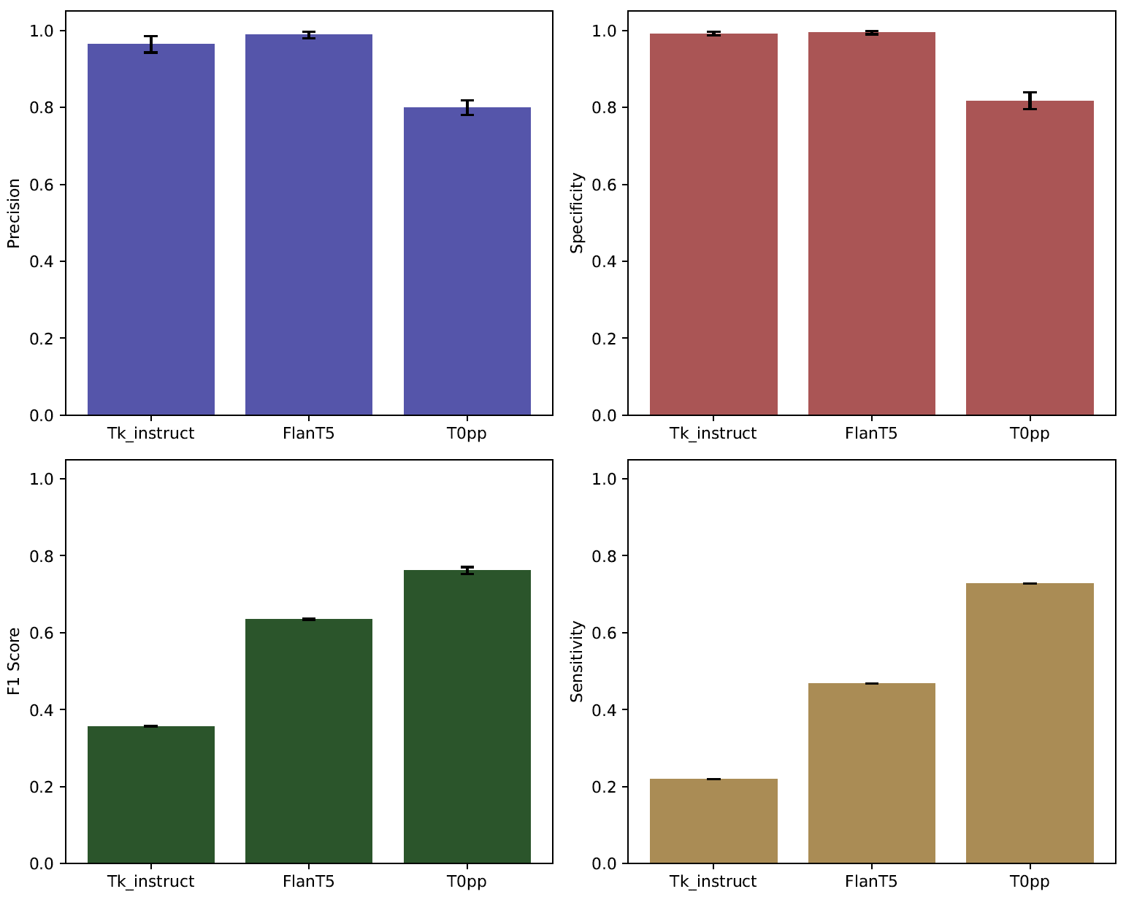



Zero-Shot learning comparing intrinsic factors by
Flan-T5-XXL & Tk-Instruct & T0pp
Tk-instruct
In this task, you are given two sentences. Indicate if the first sentence clearly entails the second sentence (i.e., one can conclude the 2nd sentence by reading the 1st one). Indicate your answer with 1 if the first sentence entails the second sentence, otherwise answer with 0
Input: Sentence 1: Evaluation Sentences
Sentence 2: This sentence is addressing or pertaining to pharmacokinetic associated with intrinsic factors .
Output: ?
Zero-Shot Learning
Precision
Specificity
T0pp
Given: Evaluation Sentences
This sentence addressing or pertaining to the pharmacokinetic properties associated with intrinsic factors. is this true?
Yes or no?
Flan-T5-xxl
Evaluation Sentences. Is this statement specifically addressing or pertaining to the pharmacokinetic properties associated with intrinsic factors?
Options:
- Yes
- No
F1 Score
Sensitivity

Slide 25
2. Introduction:
Natural language processing (NLP) methods to automatically extract and process information from biomedical literature
Relationship Extract (RE)
LLM Model to identify PK DDI sentences
Pharmacokinetic drug-drug interaction sentences
Biomedical literature corpus
PK DDI
No Pharmacokinetic drug-drug interaction sentences
Name Entry Recognition (NER)
LLM Model to identify Intrinsic factors
Pharmacokinetic drug-drug interaction sentences
Sentences relates to intrinsic factors affects drugs’ pharmacokinetics
Non-related
Traditional Machine Learning
Pre-trained language models (Bio-BERT)
3) Pre-trained Transformer base Large Language models (LLM)
Notes:
To set up these models, we have two approaches:
Traditional Machine Learning: In this approach, we manually train the model using labeled data, where it learns the relationship between different words.
Pre-trained Transformer-Based LLMs: Alternatively, we can leverage pre-trained transformer models, which already understand complex language patterns. These models only require fine-tuning on specific biomedical tasks, making them faster and more efficient to implement.
By following this approach, we aim to automate the extraction of pharmacokinetic interaction data with greater accuracy and efficiency, significantly reducing the manual workload.

Slide 26
2. Background: traditional NLP vs Transformer-base Large Language Models
1) Traditional Neural Network
Disadvantages
Training is slow and computationally expensive.
Long sequences cause vanishing gradients, leading to loss of word relationships
Pre-trained models drastically reduce training time.
It can identify complex relationships in longer sequences through attention mechanisms. (the bigger the model, the longer sequence and relationship one can process)
Advantages
2) Pre-trained Transformer base Large Language Model (LLM)
In-context learning
(Zero or few-shot learning)
Notes:
Traditional neural networks have two major limitations:
Slow Training: Training these models requires large datasets and extensive computational resources, making the process slow and inefficient.
Vanishing Gradient Problem: When dealing with long sequences, traditional neural networks often lose the relationship between distant words. For example, in a long sentence, the connection between the first and last word may be lost, making it difficult for the model to capture context accurately.
Now, let’s compare this to pre-trained transformer-based models, which leverage the attention mechanism. Imagine you’re given a book and asked to answer a question.
You have two options:
You could read the entire book from cover to cover, which might take a week and result in vague answers. Or the second option, you could go straight to the index, find the relevant chapter, and extract only the necessary information in a few minutes.
Clearly, the second approach is more efficient. This is how transformer-based large language models work—they focus on relevant parts of the input using attention mechanisms, enabling faster and more precise information extraction.
To use a transformer-based LLM, we have two main options:
Fine-tuning: Such as BioBert which we discussed earlier about this model.
In-context Learning (Zero or Few-Shot Learning): With very large language models, we can use zero-shot or few-shot learning, where the model performs tasks with minimal or no labeled data. This drastically reduces the need for large datasets and makes the model adaptable to a variety of new tasks.
In summary, transformer-based models and LLMs offer significant advantages over traditional neural networks by enabling faster training, better handling of long sequences, and the ability to perform zero-shot or few-shot learning.

